Slide 1

{
Learn the Difference between C and Java
Object-oriented programming (OOP)
}
...

Slide 2

Purpose and Paradigm:
{
Java:
C:
Java is a high-level, object-oriented programming language primarily used for developing platform-independent software applications, including web, mobile, and enterprise applications. It follows the principles of WORA.
C is a low-level procedural programming language designed for programming, such as operating systems, embedded systems, and device drivers. It provides direct access to memory and hardware resources, making it suitable for performance-critical applications.
}
*

Slide 3

Syntax and Readability
Java syntax is relatively simpler and more readable compared to C. It enforces object-oriented programming principles and provides features like automatic memory management which contributes to cleaner code.
public class HelloWorld {
public static void main(String[] args) {
System.out.println("Hello, world!");
}
}
Expected output:
Hello, world!
}
..

Slide 4
Syntax and Readability
C syntax is more complex and may appear less readable compared to Java, especially for beginners. Memory management in C is manual, requiring explicit allocation and deallocation of memory using functions like malloc() and free(), which can lead to potential memory leaks and errors if not handled properly.
int main() {
printf("Hello, world!\n");
return 0;
}
Expected output:
Hello, world!
}
..

Slide 5
Performance
C
Java
C is known for its high performance as it allows for direct manipulation of hardware resources and memory. It's often the language of choice for performance-critical applications where speed is paramount.
Java typically has slowe﻿r performance compared to C due to its platform independence and runtime environment overhead. However, advancements in JIT (Just-In-Time) compilation and optimization techniques have narrowed the performance gap in many cases.
...

Slide 6


{
Portability
Java programs are highly portable due to the JVM, which provides a layer of abstraction between the application code and the underlying hardware and operating system. Once compiled to bytecode, Java applications can run on any platform with a compatible JVM implementation.
}
...

Slide 7



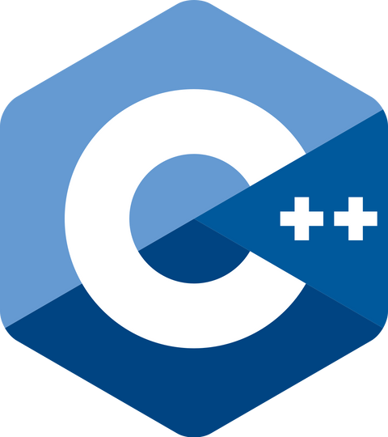
{
Portability
C programs are less portable compared to Java because they are compiled directly to machine code, which is specific to the target platform's architecture and operating system. Porting C programs to different platforms often requires modification and recompilation.
}
...

Slide 8

Usage and Domains
01
Web Dev
Java Enterprise Edition is commonly used for
developing enterprise web applications.
02
Mobile App Dev
Java is the primary programming language for
Android app development.
03
Enterprise Software Dev
Java is widely used for developing enterprise-level software solutions.

Slide 9
Usage an﻿d Domains
01
System Programming
C is extensively used for system programming tasks such as developing operating systems, kernels, device drivers, and firmware.
02
Game Dev
C is widely used in the gaming industry for developing game engines, graphics libraries, and game logic
03
Performance-Critical Applications
C is chosen for applications where performance is critical, such as real-time systems, high-frequency trading platforms, and computational-intensive applications, etc.

Slide 10
Thanks!
< Do you have any questions? >
Ricardo Robles Abad
Paola de Jesus Rebollar cruz
CREDITS: This presentation template was created by Slidesgo, and includes icons by Flaticon, and infographics & images by Freepik

Slide 11

Referencias
}
Saavedra, J. A. (2023, June 1). Qué es lenguaje C: las ventajas, las características y la sintaxis. Ebac. https://ebac.mx/blog/que-es-lenguaje-c
¿Qué es Java? - Explicación del lenguaje de programación Java - AWS. (n.d.). Amazon Web Services, Inc. https://aws.amazon.com/es/what-is/java/
GfG. (2023, February 21). Difference between Java and C language. GeeksforGeeks. https://www.geeksforgeeks.org/difference-between-java-and-c-language/
GfG. (2023, February 21). Difference between Java and C language. GeeksforGeeks. https://www.geeksforgeeks.org/difference-between-java-and-c-language/
*

